Slide 1




Keylogger Detection
Dive into the world of keylogger detection systems. Uncover hidden threats and safeguard your digital environment.
By
Nathanael A Thomas
Austin Devodass
Shobit Jain
E23MCAG0068
E23MCAG0059
E23MCAG0089

Slide 2

Introduction to Keylogger Detection
Understanding the Threat
Detection Strategies
Keyloggers pose a serious security risk, silently recording every keystroke and potentially exposing sensitive data.
Effective keylogger detection requires a multi-faceted approach, combining software monitoring, behavior analysis, and hardware inspection.
Proactive Approach
Staying ahead of keylogger threats requires vigilance, regular security checks, and a deep understanding of detection techniques.

Slide 3


Understanding Keyloggers
Keyloggers are software or hardware devices that record keyboard inputs, including passwords, credit card numbers, and other sensitive information.
They can be used for malicious purposes, such as identity theft and financial fraud.
Keyloggers can be difficult to detect as they often run in the background without the user's knowledge or consent.

Slide 4


The Threat of Keyloggers
Keyloggers pose a grave security risk, allowing criminals to silently monitor and steal sensitive data like login credentials, financial information, and personal communications. These invisible malware can infiltrate devices through various vectors, posing a constant threat to individuals and organizations alike.
The devastating consequences of keylogger exploitation can lead to identity theft, financial fraud, and breached privacy - undermining trust and security in the digital world.

Slide 5
Keylogger Detection Techniques
Automated Scanning
1
Specialized software scans the system for suspicious processes, unusual network activity, and potential keylogging indicators.
2
Hardware Inspection
Physically inspecting the system for any foreign hardware devices, such as hidden USB dongles, that could be keyloggers.
Behavioral Monitoring
3
Analyzing user input patterns and system events to detect anomalies that may indicate the presence of a keylogger.

Slide 6
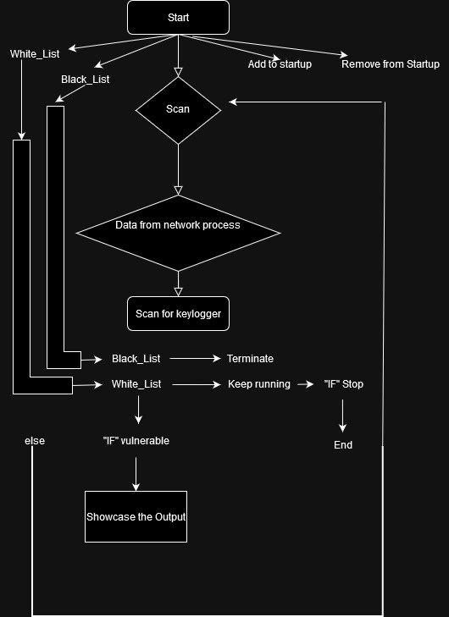
Methodology
This program focuses on combating keylogger software by monitoring all running applications, targeting those attempting to communicate through popular SMTP ports for Gmail, Yahoo, ATT, Microsoft, and AOL for both Windows and Linux machines. Once the software has targeted an application that is communicating through specific SMTP ports, the process will be paused, and the user will be notified of the potential threat. Then, the user will be asked if this process should be added to a trusted whitelist to continue running as normal or kill the process immediately and be added to a blacklist so that any other time this process is detected it will be automatically terminated.

Slide 7




Implementation
System Architecture
Keylogger Monitoring
Behavioral Analysis
Designing a modular and scalable architecture to support keylogger detection across multiple platforms and environments.
Implementing real-time monitoring of system activities to identify suspicious patterns indicative of keylogging behavior.
Developing advanced algorithms to analyze user input, network traffic, and system events for anomalies that may signify the presence of a keylogger.

Slide 8
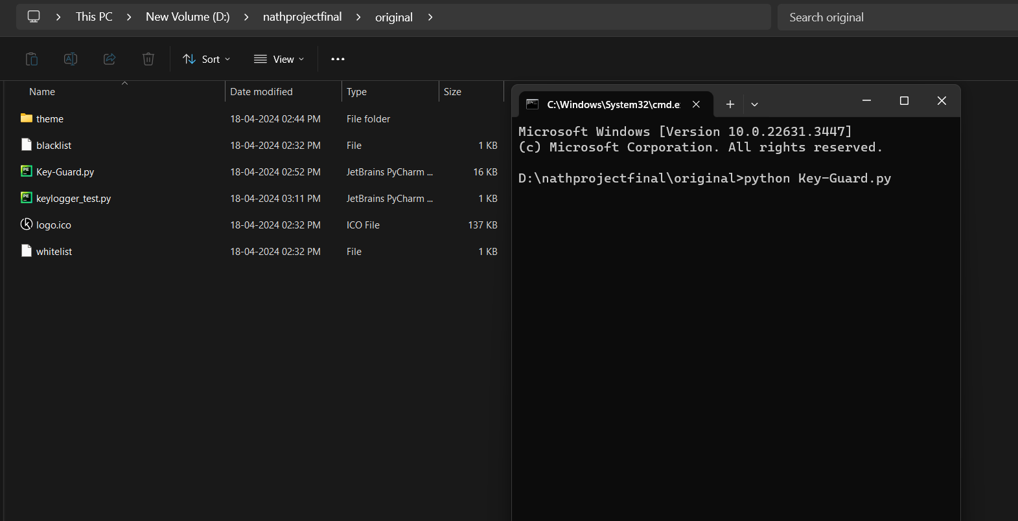
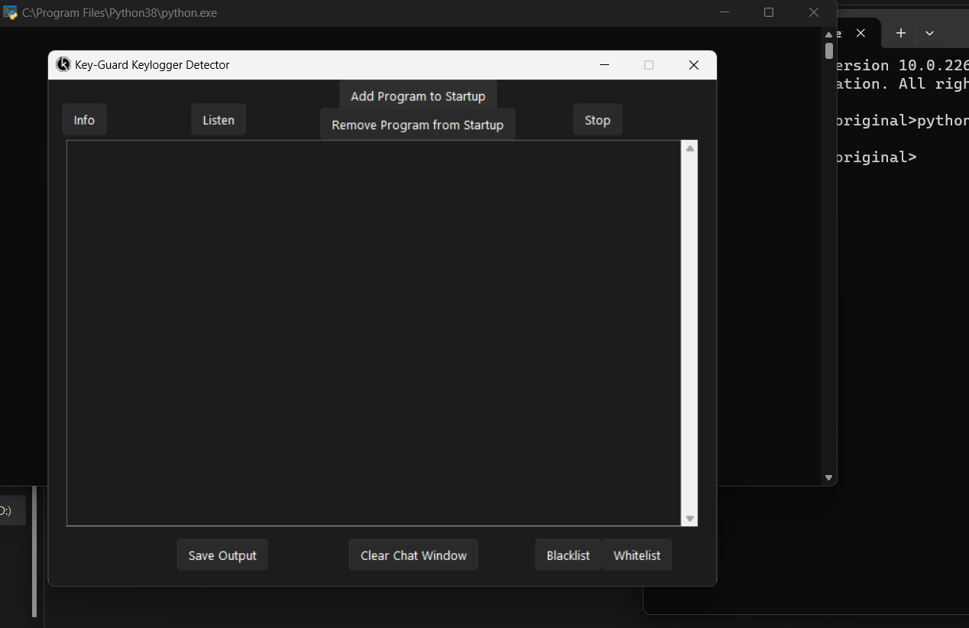
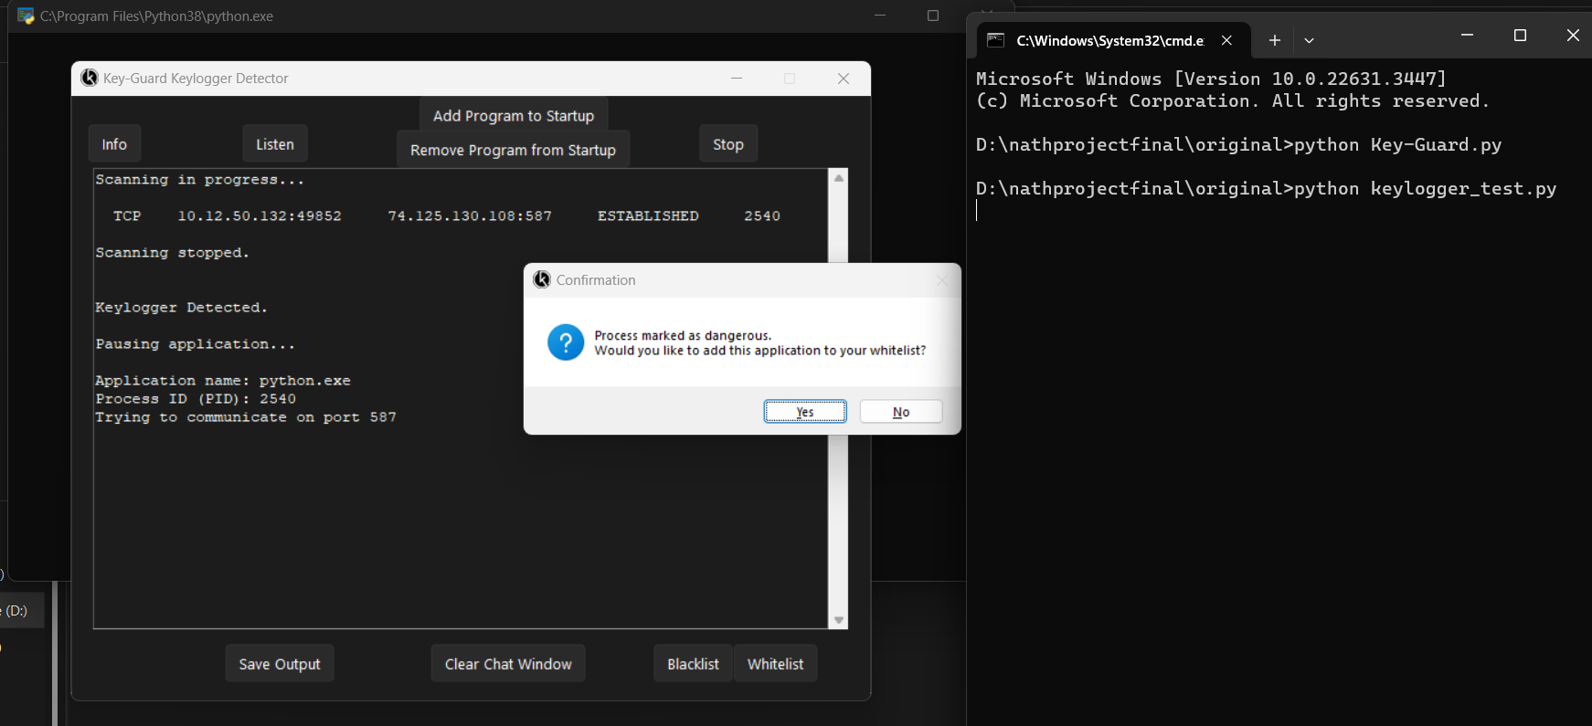
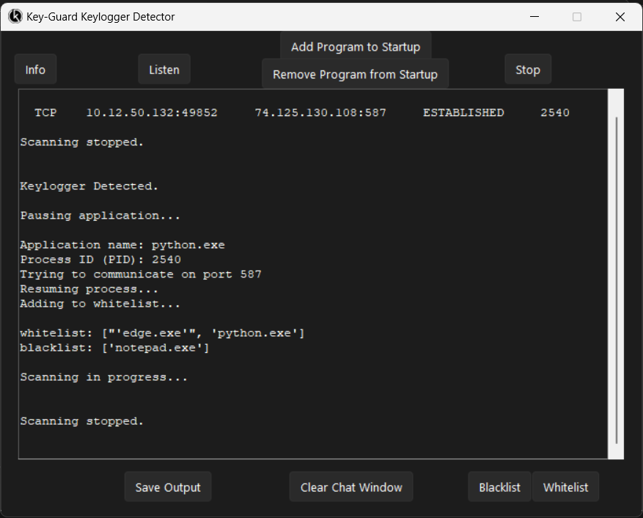

Slide 9
RESULT

Slide 10
Conclusion
Proactive Protection
Continuous Monitoring
A comprehensive keylogger detection system is crucial for safeguarding against malicious data theft and privacy breaches.
Ongoing surveillance and analysis of system behavior is key to rapidly identifying and mitigating keylogger threats.
Empowering Users
Future Directions
Educating users on keylogger detection best practices enhances individual and organizational cybersecurity posture.
Advancing keylogger detection research will strengthen digital defenses and protect sensitive information in an evolving threat landscape.

Slide 11
Acknowledgments and Resources
Cybersecurity Experts
Educational Resources
Continuous Learning
We would like to extend our sincere gratitude to Mr. Rajesh Kumar Shrivastava and Rishi Dhutt Sharma our Facility , for his invaluable guidance, expertise, and support throughout the development of this project. His insights have been instrumental in shaping our approach and enhancing the security measures implemented.
Special thanks are also due to Bennett University for providing the necessary resources and environment for conducting this research. The institution's commitment to excellence in education and research has greatly facilitated the success of our endeavors.
Stay updated on the latest threats and detection techniques through ongoing training and research.

